Slide 1

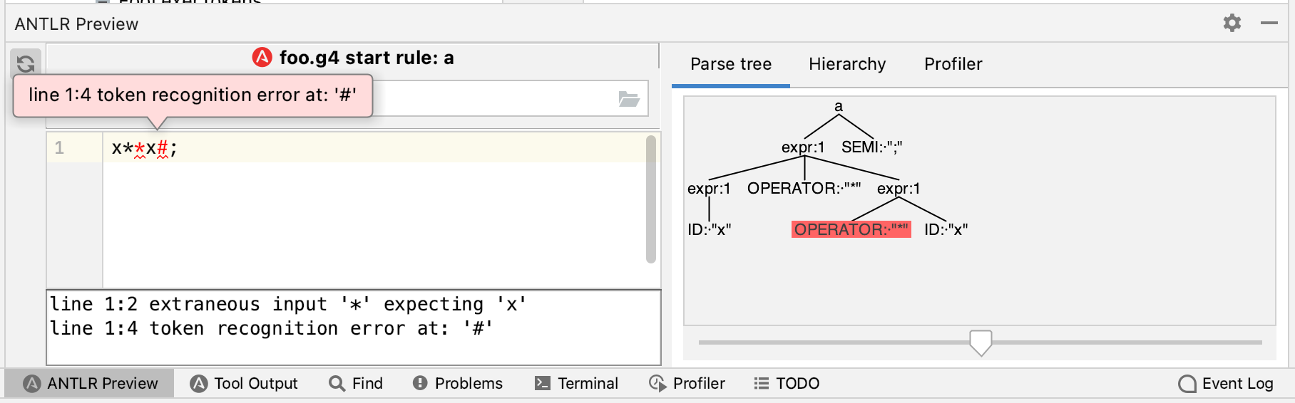
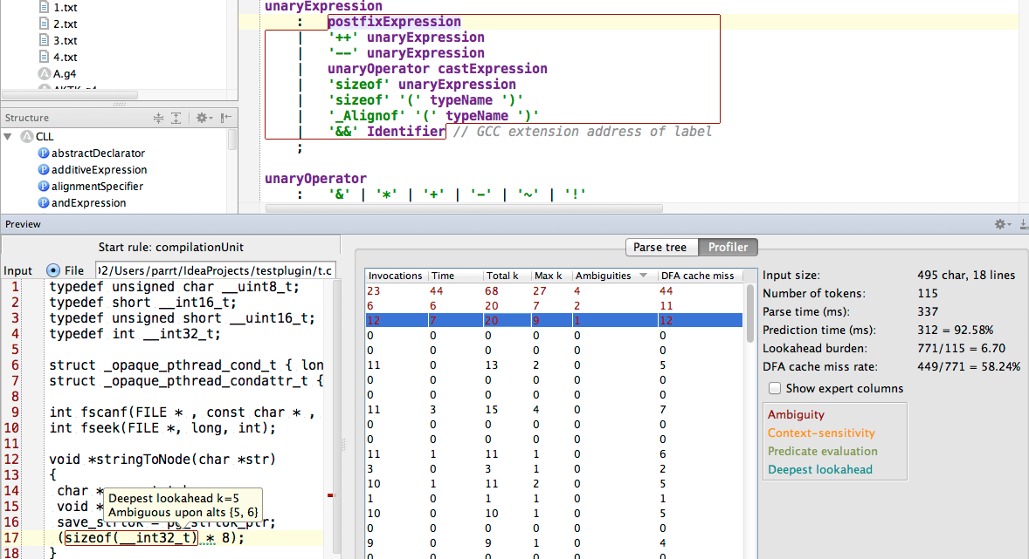
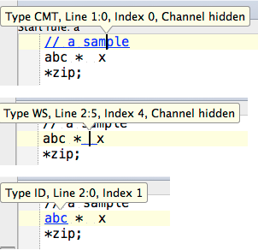
A quick self-intro…
Terence Parr University of San Francisco
“Why program by hand in 5 days what you can spend 5 years of your life automating?”

Slide 2
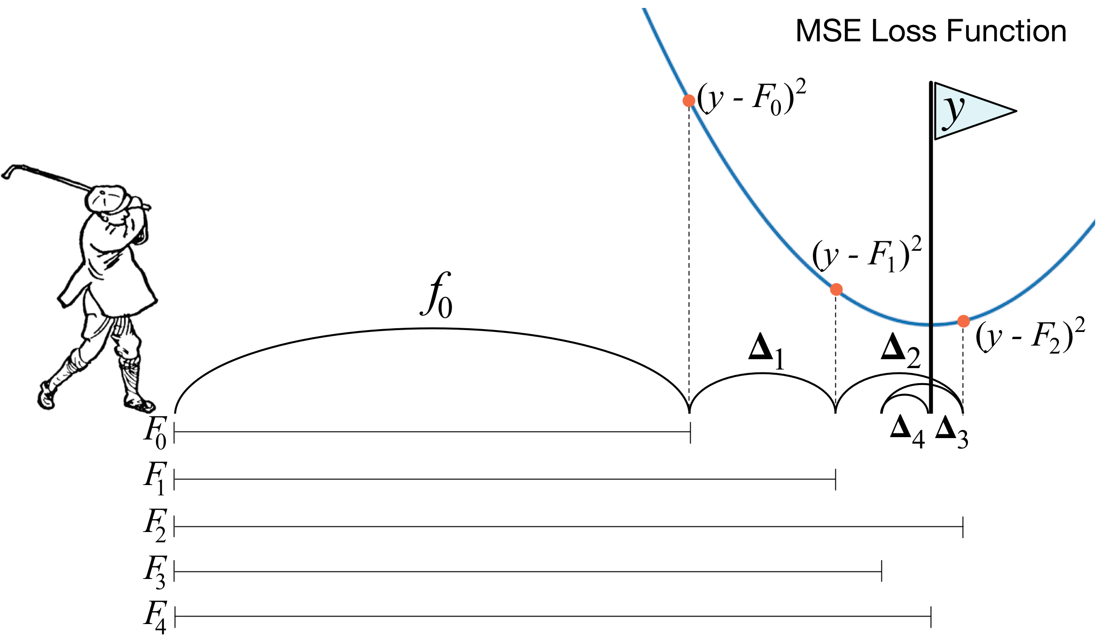
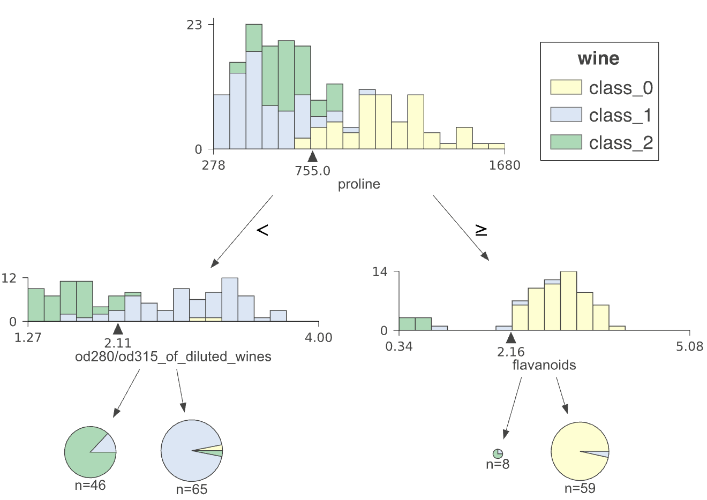
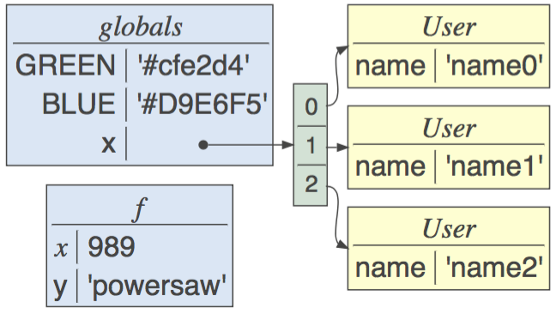
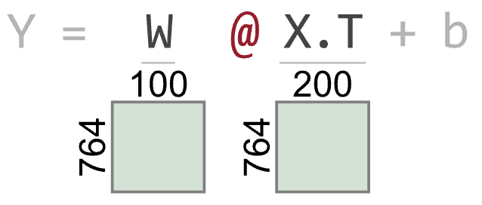
And now for something completely different…
https://explained.ai/
dtreeviz
lolviz
TensorSensor

Slide 3
Clarifying matrix algebra exceptions in Python visually with TensorSensor
Examples and implementation details
Terence Parr University of San Francisco
See https://github.com/parrt/tensor-sensor and https://explained.ai/

Slide 4
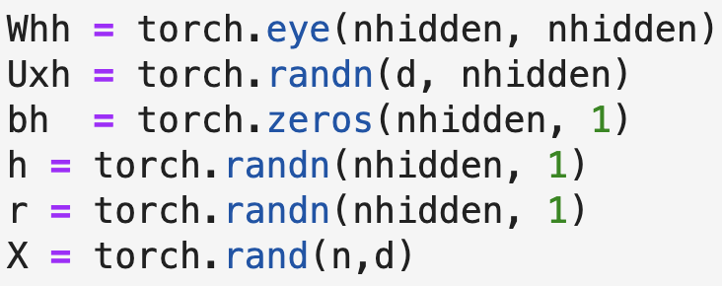

The problem
It's easy to lose track of matrix/tensor dimensionality in matrix algebra expressions (even in statically-typed languages)
Upon error, we often get less than helpful exception messages, such as this (PyTorch) message:
The offending operator and operands are not identified, since Python exceptions occur at the line level rather than the operator level

Slide 5
We could rerun using the debugger but…
The debugger still does not tell us which subexpression caused the exception, due to line-level granularity of Python exceptions
We must write down shape of all operands then line up and compare dimensions on all subexpressions manually
Besides
Python debuggers seem much slower than normal execution
Even regular execution could take hours before faulting
Sometimes it's hard to set a breakpoint on the right statement when it's in a loop
Conditional breakpoints are challenging when the values are high-dimension matrices

Slide 6
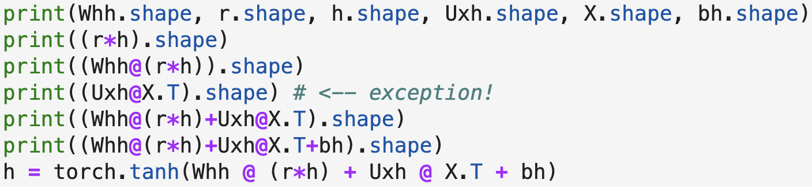
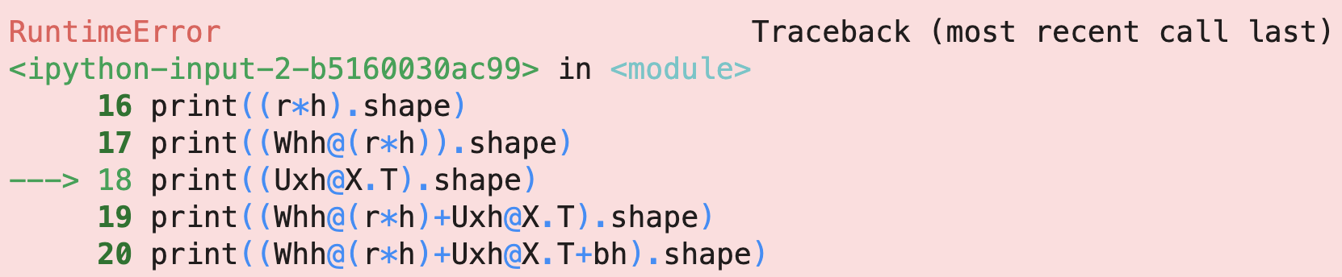
What most people do
😿
Most data scientists laboriously inject code and rerun to isolate:
Or, they stop here

Slide 7

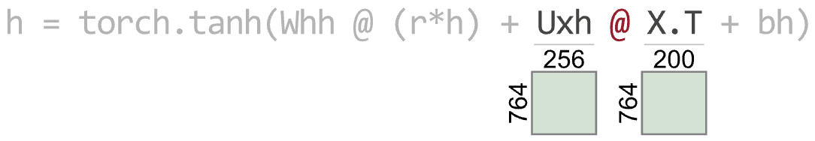
What TensorSensor proposes
🎉
First, augment the exception message to identify the op/opnds:
But we can help programmers even more…
The key is to line up dimensions, so let’s show that visually!
Believe it or not, this is all matplotlib

Slide 8
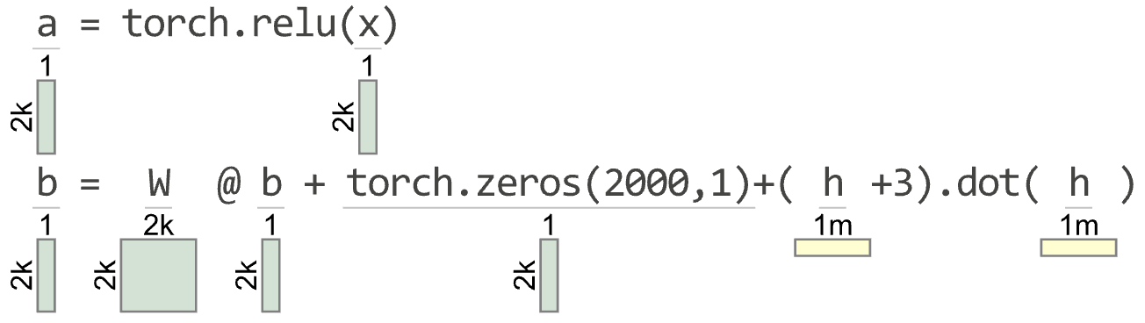
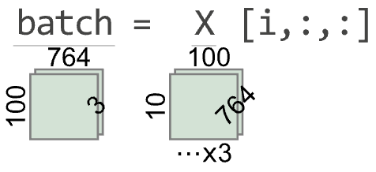
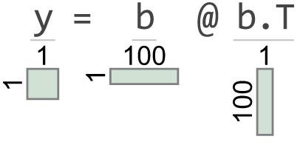
A nice-to-have feature: viz correct code
Very helpful when trying to read (even correct) code
Greater than 2 and 3 dimensions

Slide 9
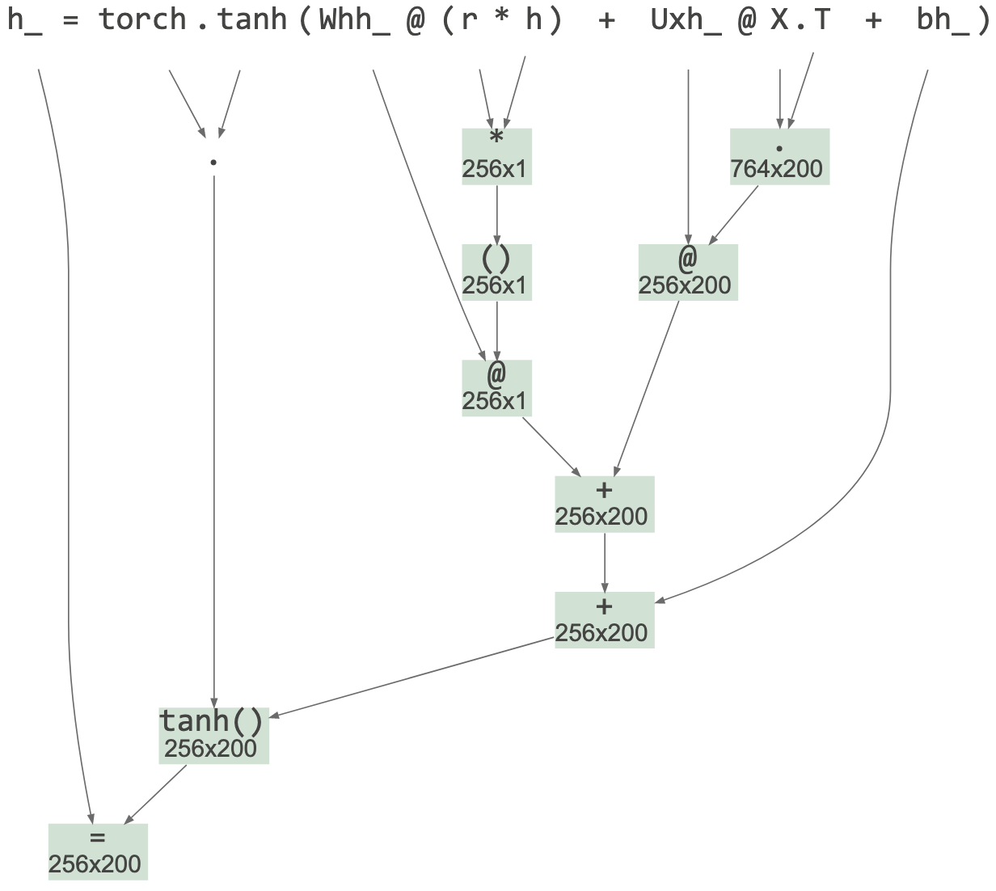
A nice-to-have feature: Abstract syntax trees with dimensions
Shows tensor dimensions for all subexpression partial results
(currently must call explicit function)

Slide 10
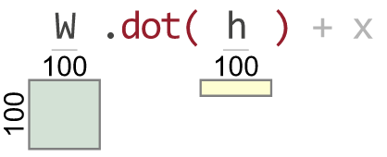
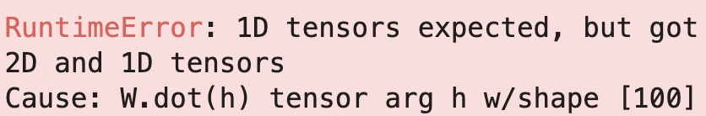
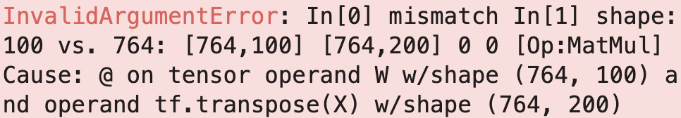
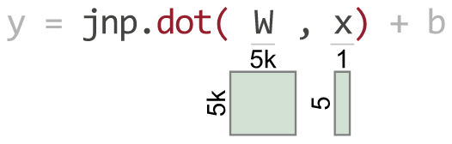
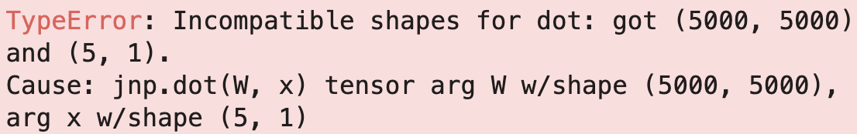
Oh, and support multiple libraries
(1D vectors are yellow)
PyTorch
TensorFlow
JAX

Slide 11
Design goals (knowing what to build is as important as knowing how to build)
Should be as unobtrusive as possible with least user effort
Users shouldn’t have to reorganize code
Trap just matrix-related exceptions
Avoid need for an external tool or translator
Avoid spewing output until exception occurs
Can we avoid CPU cost until an exception?
Ideally, implementation would be small and straightforward (at least to language engineers)

Slide 12
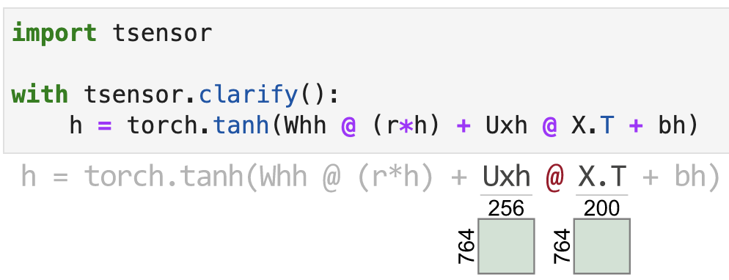
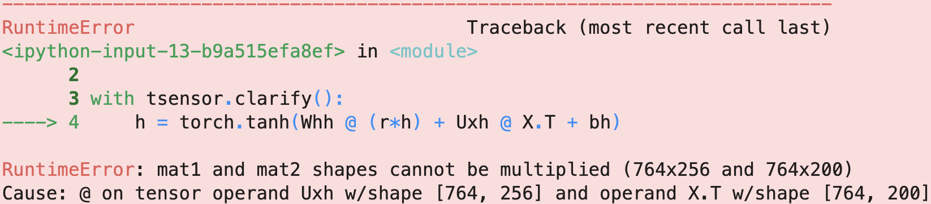
TensorSensor programmer interface
The Python with statement gives us the hooks we need
(From within a Jupyter notebook)
No need to inject code
No need to rerun

Slide 13
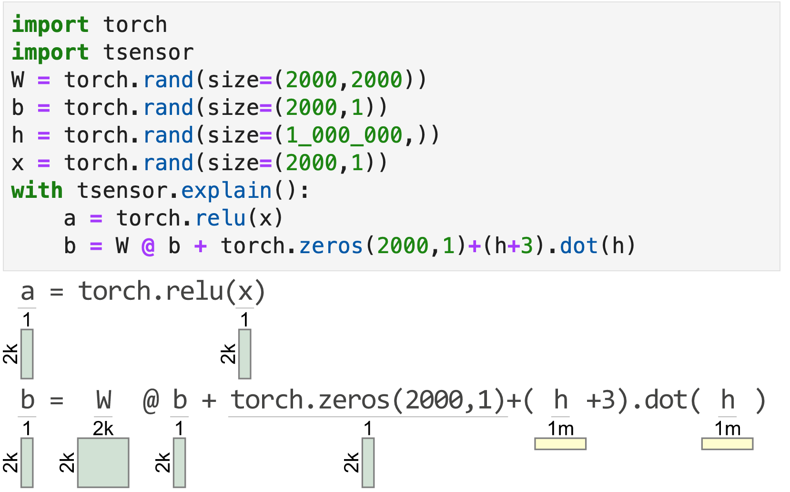
Explaining correct matrix code
clarify() has no effect unless tensor code triggers an exception
But explain() gens a visualization for each statement within the block

Slide 14
Approaches I rejected
Python decorators: would require wrapping user code in functions
Try/except blocks
Program rewriting is complex and requires a separate tool
Bytecode injection:
slows down entire program
could require huge cache of subexpression partial results
function-level granularity
🤢
try:
… my code …
except Exception as e:
tsensor.do_everything(e)
(might not be able to hide everything here, like reraising e)

Slide 15
TensorSensor implementation

Slide 16
Impl. relies on “context manager” objects
Python "with b" blocks call __enter__(), __exit__() on object b and exit method receives exception object and execution stack
clarify() needs the exception object to augment messages and the execution stack to obtain subexpression values, identify offending operator
__exit__() can automatically gen visualization in notebook or pop-up a window if run outside a notebook
There’s no cost unless exception occurs within the with block

Slide 17
TensorSensor’s explain() mechanism (Visualizing correct Python code on-the-fly)
explain() object's __enter__() method creates a tracer object and registers it with Python via sys.settrace() [1]
The tracer is notified upon each source line execution
Using same mechanism as clarify() to identify operand shapes
Even in a loop within with block, statements visualized just once
Slows down execution (a lot) but it's still useful
[1] https://docs.python.org/3/library/sys.html#sys.settrace

Slide 18
Getting operator-level exceptions w/o bytecode instrumentation requires a total hack
We have: (1) the full execution stack from which we can get (2) the offending line of source code (inspect.getframeinfo())
To identify the individual operator and operands that triggered an exception, use brute-force:
reevaluate each operation in the line, piece-by-piece, in proper order, and in the correct execution context (must pick correct stack frame)
Wait for an operator to cause an exception, report op/opnds
Assumes side-effect free operations
Even if side-effecting, who cares (usually)? The program is about to terminate
Warning:
Prints "hi" twice:
with tsensor.explain(): print("hi")

Slide 19
Reevaluation mechanism
First, check if exception is tensor-related or if exec stack descends into a known tensor lib
If so, scan stack to find and parse deepest user-level offending statement and build an appropriate AST with operators as subtree roots
Uses built-in Python tokenizer
Uses handbuilt Python parser for subset of statements / exprs
Avoided ANTLR to avoid introducing a lib dependency
Avoided built-in Python parser since reorg'ing its AST is same work as rolling my own "parrser"
🤣
(also from TensorSensor lib)

Slide 20
Reevaluation mechanism continued
Evaluate operators of AST bottom-up in proper exec order
Call eval() on Python source of subexpressions using the appropriate execution contexts, saving results in associated nodes
Trap and absorb exception from eval(), record that exception and offending AST node
Augment original exception message with info derived this new exception, op, operands

Slide 21
Picking the right execution context
The goal is to identify user code not library code that (eventually) triggers a tensor-related exception
TensorSensor clarify() descends into any user code function calls, stopping only when it reaches a tensor library function
Source file prefix indicates user code boundary, such as: …/lib/python3.8/site-packages/tensorflow/…
Boundary frame is any whose package is in {numpy, torch, tensorflow, jax}

Slide 22
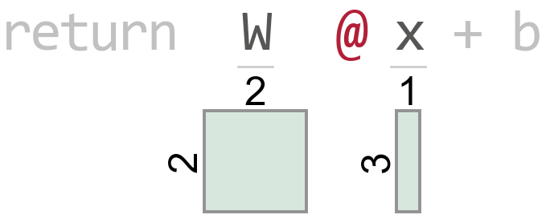
Example: Picking the execution frame boundary
t.py source
Execution stack
def f(x): W = tf.constant([[1, 2], [3, 4]]) b = tf.reshape(tf.constant([[9, 10]]), (2, 1)) return W @ x + b # line 4 with tsensor.clarify(): x = tf.reshape(tf.constant([[8, 5, 7]]), (3, 1)) y = f(x) # line 8
t.py:8 (in main)
t.py:4 (in f)
math_ops.py:1124
dispatch.py:201
math_ops.py:3253
gen_math_ops.py:5624
ops.py:6843
Raises exception

Slide 23
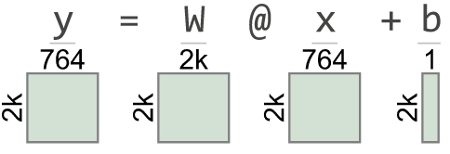
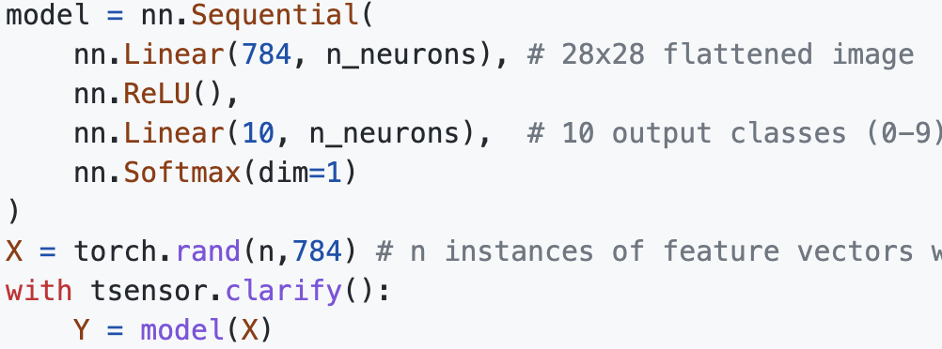
Examples of future work
Lots of meat still on the bone
Add tensor element type to messages and visualizations
we don’t want integers becoming floats if they are used as indexes
might need to restrict to 32 bits
Viz errors in predefined layers; currently highlights model(X) not layer in nn.Sequential
This promotes all to float64
float64
float32
float32
float64

Slide 24
Summary
parrt: run demo!
Finding and implementing an unobtrusive mechanism took a lot of experimentation (and had to learn about Python’s rich runtime)
TensorSensor users think that visualization was the hard part, but that was just painful not hard (I abused matplotlib horribly!)
The tricky bit was getting fine-grained exceptions from Python
The key idea is to reevaluate the offending line operator-by-operator and wait for the exception to happen again
Involves extracting the source line, parsing into an AST, then calling eval()
Language engineering is useful far beyond building compilers and interpreters
Article: https://explained.ai/tensor-sensor/index.html
Code: https://github.com/parrt/tensor-sensor

